Slide 1

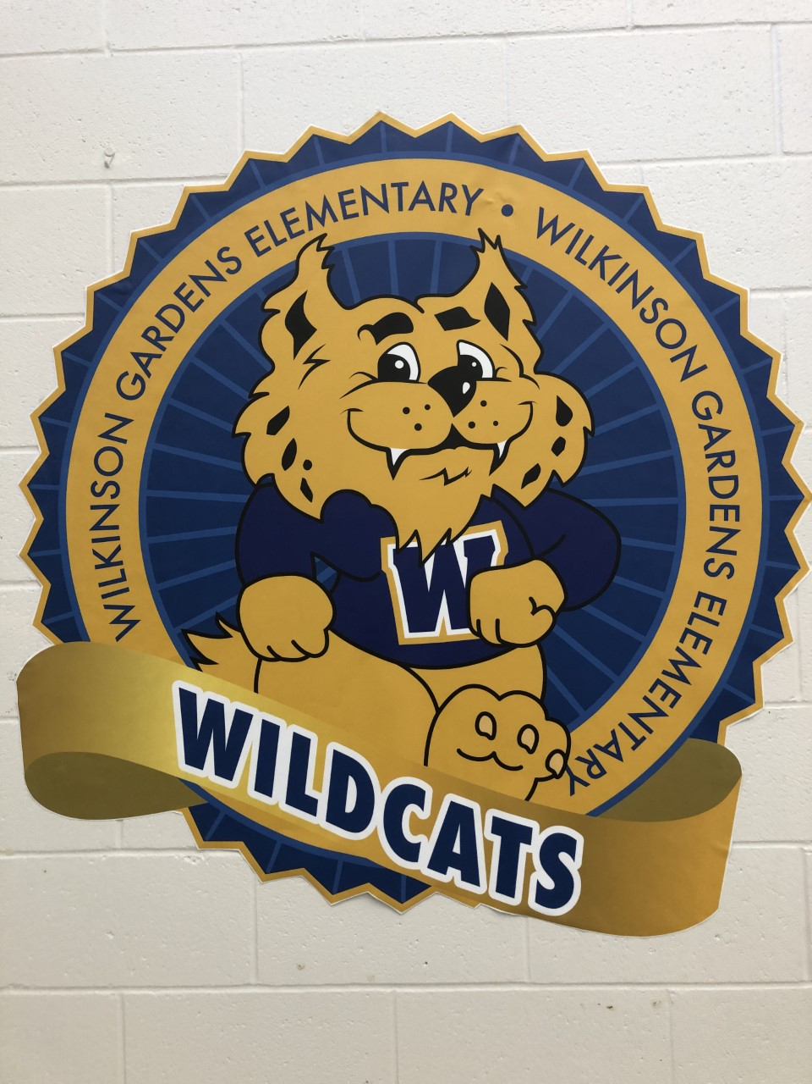
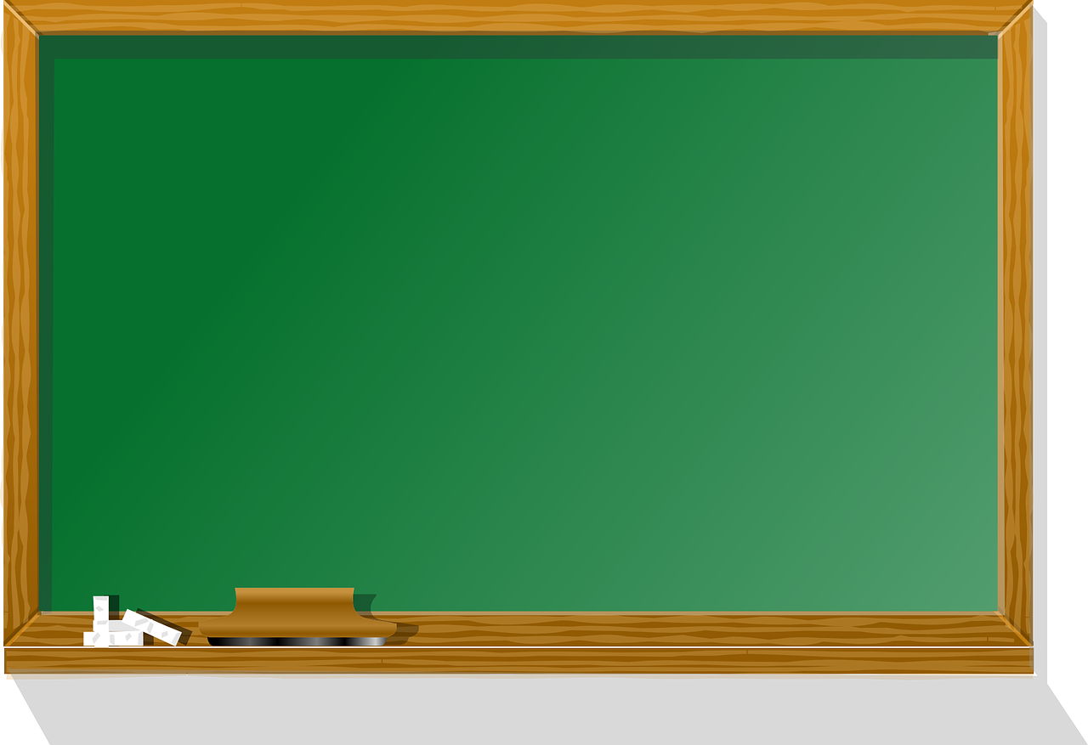

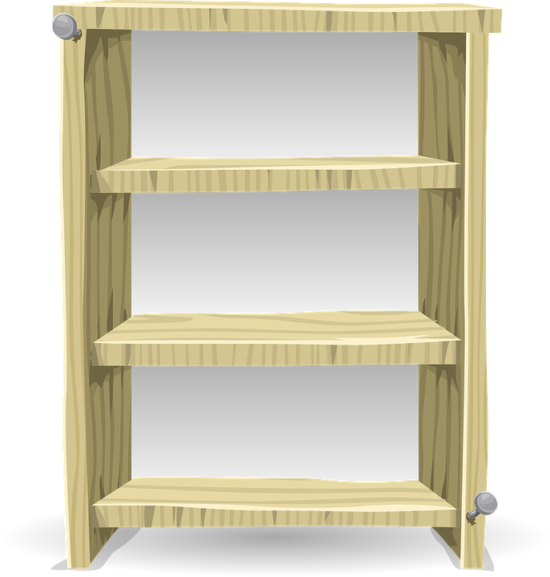



Welcome to First Grade
Wilkinson Gardens Elementary School
Dr Kathleen Mainhart
RCSS Launch Pad
Syllabus
Wildcats ROAR
School Calendar
Click on me to find out more about me.

Slide 2
All About Me
Hello First Graders and Parents,
My name is Dr. Mainhart and this is my second year teaching at Wilkinson Gardens Elementary School in Georgia. I am very excited to be your teacher this year. We will learn lots of wonderful things.
I graduated in 1985 from Goucher College with a BA in Elementary Education and English. I spent two years as a Peace Corps Volunteer in Morocco and when I returned to the United States, I taught in New Hampshire and Virginia. While in Virginia, I attended the University of Virginia and got my M.Ed and Ph.D in Educational Evaluation. My research involved looking at how experienced teachers incorporated multicultural education into their classroom. Since then I have taught in New York City (both elementary and graduate education) and in the United Arab Emirates.
I am pleased to be in Georgia and to be teaching grade 1 at Wilkinson Gardens.

Slide 3
1st Grade Syllabus
ELA
• Sight words, blending, & segmenting
• Grammar (nouns, verbs, adjectives, conjunctions, etc.)
• Writing, directions, & opinions with a focus on handwriting
• Reading different kinds of texts (informational and literary)
Math
• Solving addition and subtraction word problems in situations of adding to, taking from, putting together, taking apart, and comparing (e.g. a taking from situation would be: “Five apples were on the table. I ate some apples. Then there were three apples. How many apples did I eat?”)
• Quickly and accurately adding with a sum of 10 or less and quickly and accurately subtracting from a number 10 or less (e.g. 2 + 7, 7 - 5)
• Understanding what the digits mean in two-digit numbers (place value)
• Using understanding of place value to add and subtract (e.g. 38 + 5, 29 + 20, 64 + 27, 80 – 50)
• Measuring lengths of objects by using a shorter object as a unit of length
• Making composite shapes by joining shapes together, and dividing circles and rectangles into halves or fourths

